Slide 1

CptS 122 L8
Lab GH Link: https://github.com/swiftlydesigner/122-Practice-Review
Boring Part – Lab Guidelines

Slide 2

Review Class Expectations
Lab Canvas Page > Modules > General Info > Expectations.pdf

Slide 3
Asking friends/colleagues for help
Set aside time for them to explain how to complete the objective
DO NOT COPY/PASTE THEN EXPLAIN – THIS IS PLAGARISM
While you can work with others on higher-level features (UI), credit must be given
Please keep this code to a minimum. If there is too much similar work (even credited), it will likely end in a 50-100% point reduction
Be sure that everybody involved can write the code for the objective

Slide 4
Office Hours
Dana 134
Day: Tue
Hours: 14:00-16:00
I can show up early upon 18-hour notice (20:00 Monday)
Email for in-person or Zoom appointment if you cannot make it or need more help. Depending on my schedule, I may do Zoom appointments on the weekends and over breaks.

Slide 5
Contact
(Preferred) Message me on MS Teams @ kyle.parker
Email me at kyle.parker@wsu.edu
I typically respond within an hour if I am not in class or working on an assignment. Give me 24-48 hours incase I am busy some day
I can only respond to emails from your WSU email (FERPA regulation)
If you email me, Include “CPTS 122 L8:” in the subject
Contact me to:
Setup appointments
Ask questions or need clarifications on assignments
Let me know you are missing a lab
Let me know you are missing an exam (Attempt to contact Andy first)
Limited acceptable reasons

Slide 6
Recommendations for Success
Ask questions as they come up (whether you are in lab or lecture)
Attend office hours when you do not grasp concepts
Use whiteboards at home and in lab (will be very helpful)
Work in groups
Watch videos on specific topics
Ask classmates or any other person you know who is good with these concepts
Do not:
Copy/paste from friends or the Internet
Copy from the Internet without understanding the content

Slide 7
Recommended Websites
Documentation
cplusplus.com
Tutorials
w3schools.com
tutorialspoint.com
geeksforgeeks.org
Youtube video
Use dorking to search if you find a site you like
i.e., `atoi site:cplusplus.com` <= Will search for atoi only on cplusplus.com

Slide 8
Stack Overflow
It is good and bad
Sometimes it will give you a good answer with actual reasoning
Other times you will get the correct answer, but with no or wrong reasoning
Always make sure you understand what you use
If you cannot explain it, don’t use it
Always cite the source. Even if it is a single line

Slide 9
Extra Credit
(In Lab) I will make questions that are difficult
It may be solving a problem
It may be telling me what the function will return given some input
1-2 points, based on difficulty
(In Lecture) Andy grades some assignments at the end of this semester
Be sure you submit them to Andy via email – I do not grade these

Slide 10
Questions?

Slide 11
Introductions
Name
Degree & class standing. What made you choose it?
Experience with code (What languages, if any)

Slide 12
Lab #1 – Section 8
GitHub – Watch my Video

Slide 13
Signup at github.com
You can either create a student account and gain access to some features:
https://education.github.com/pack

Slide 14
We will use GH For all slides
I will post all content from labs to GH
I will post review material to GH
I will post any code we go over on GH
I will post request content on GH
Depending on time, I may provide some starter code for a lab (it will be advanced) and you will build from it
This does not mean you must create an account, but I strongly encourage it
It will help with the final project in this class!

Slide 15
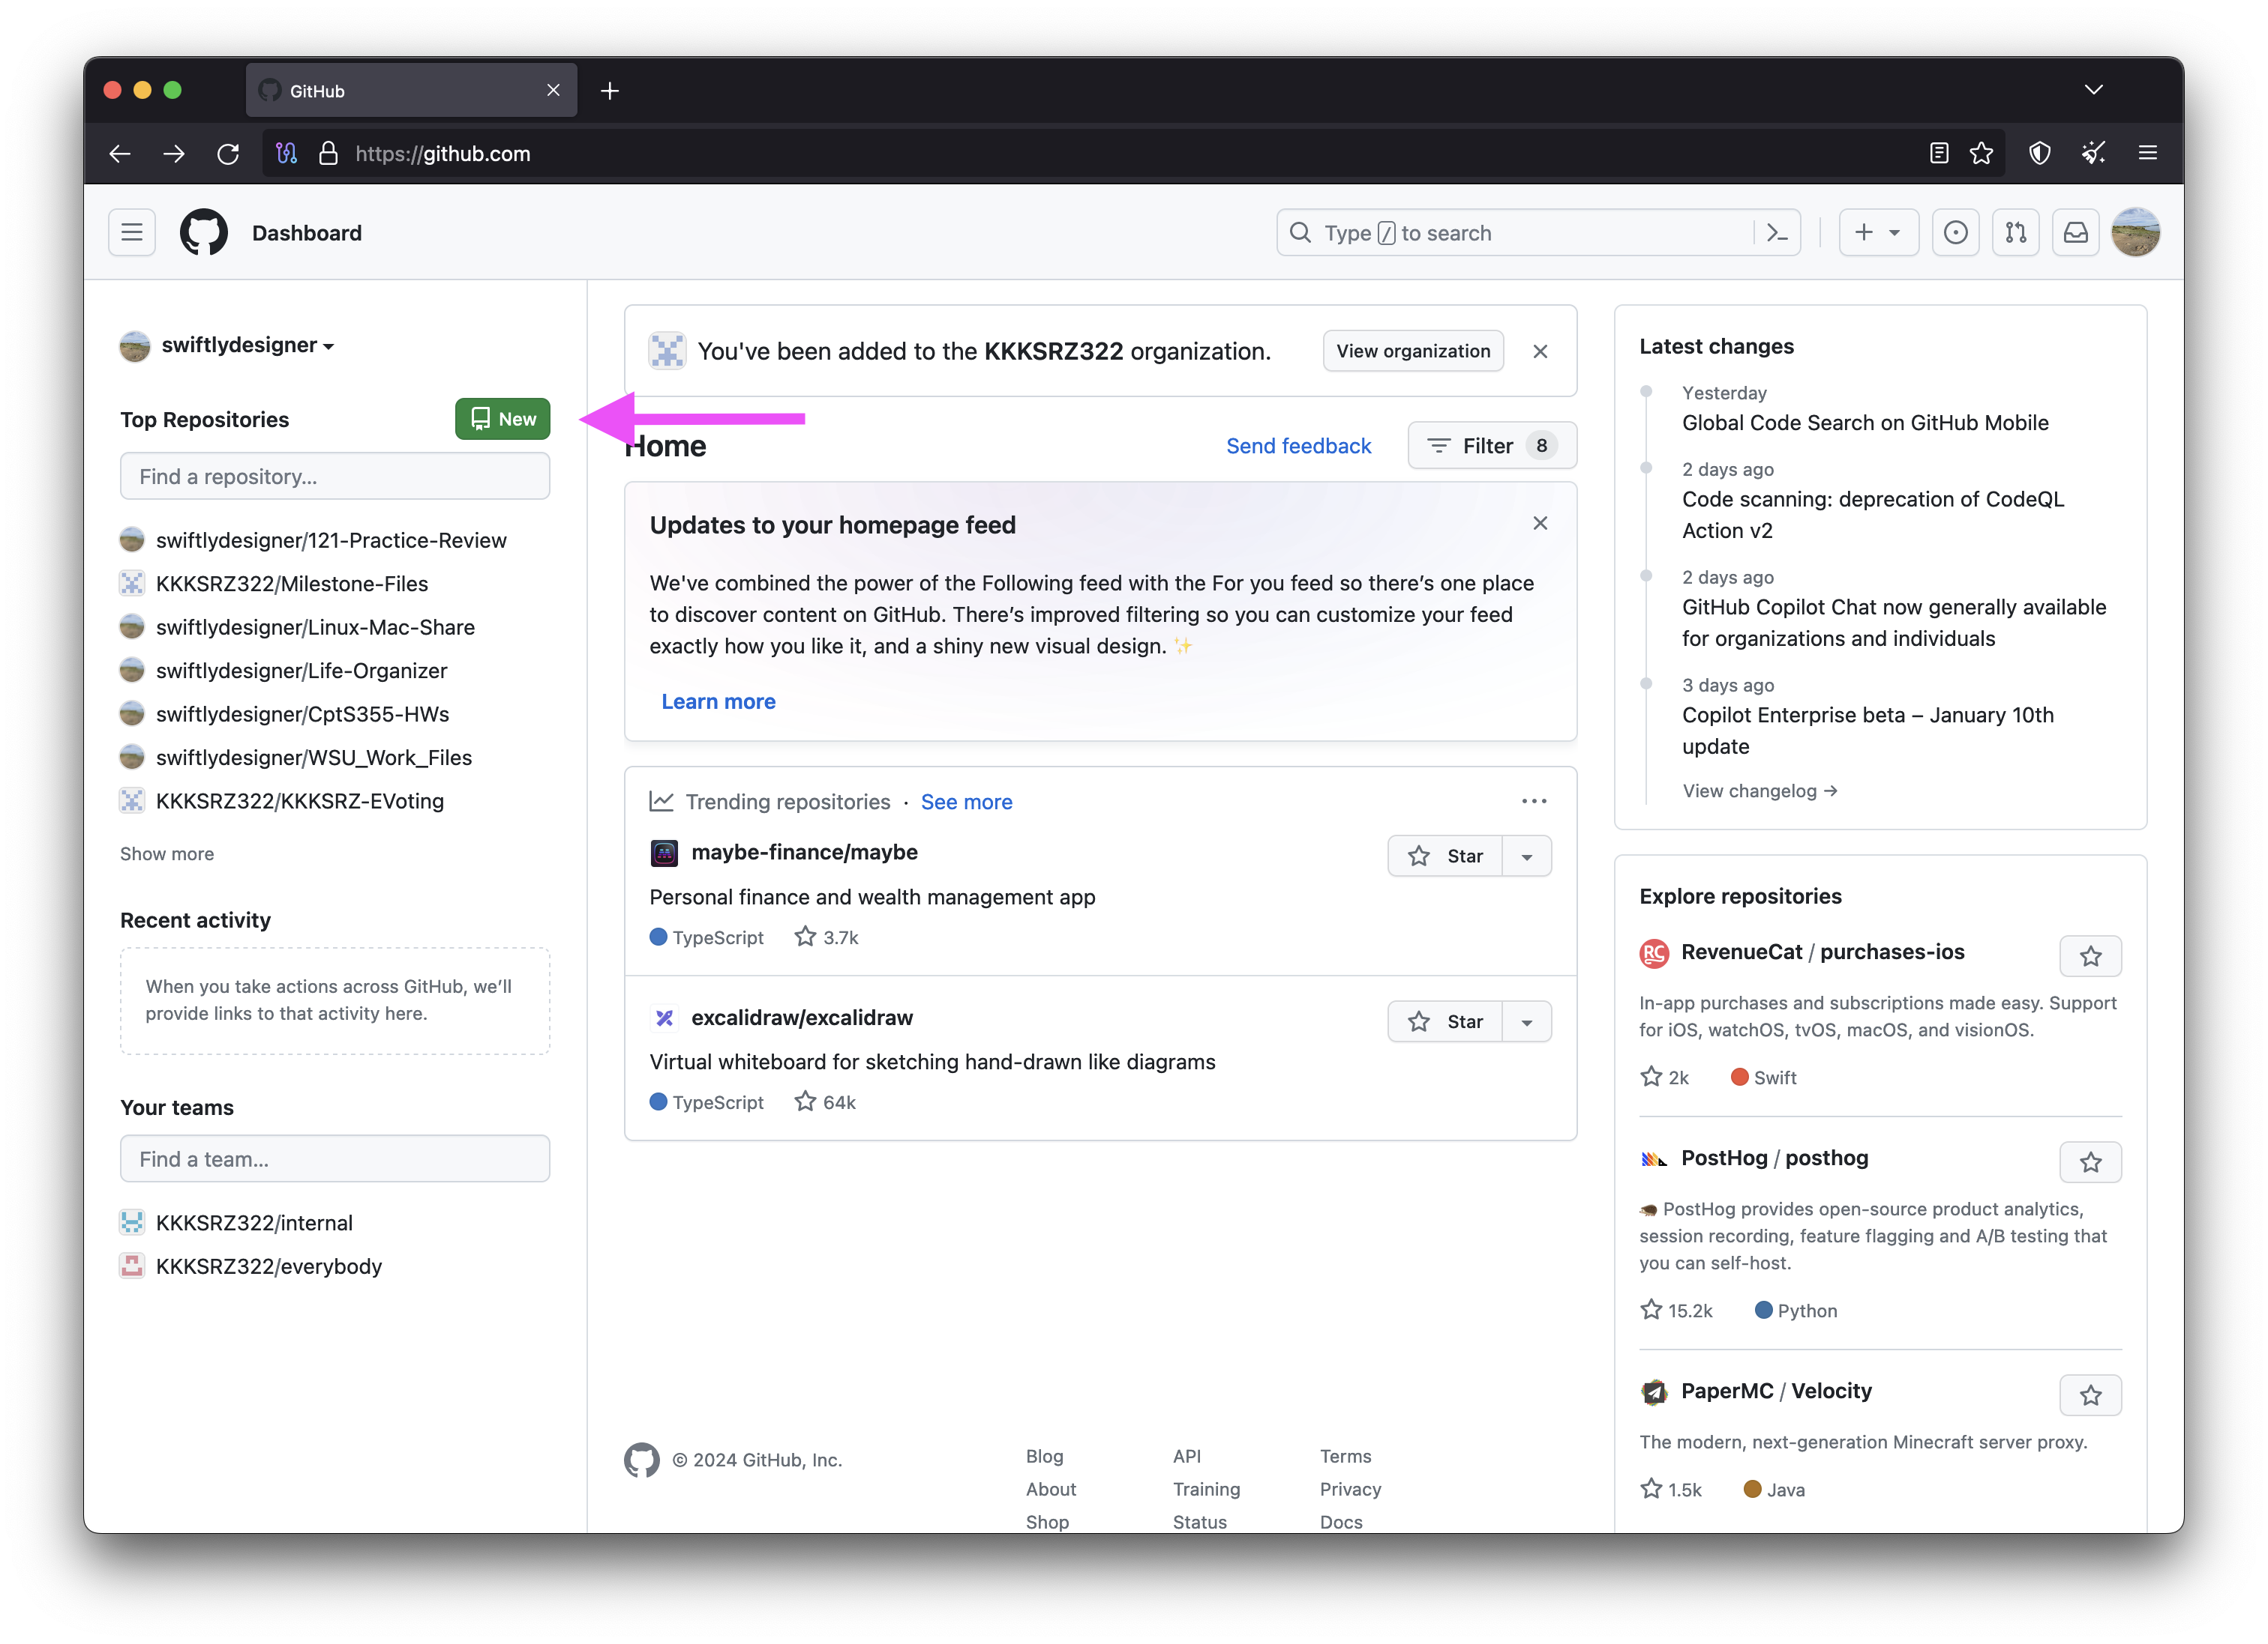
Create a new Repo

Slide 16
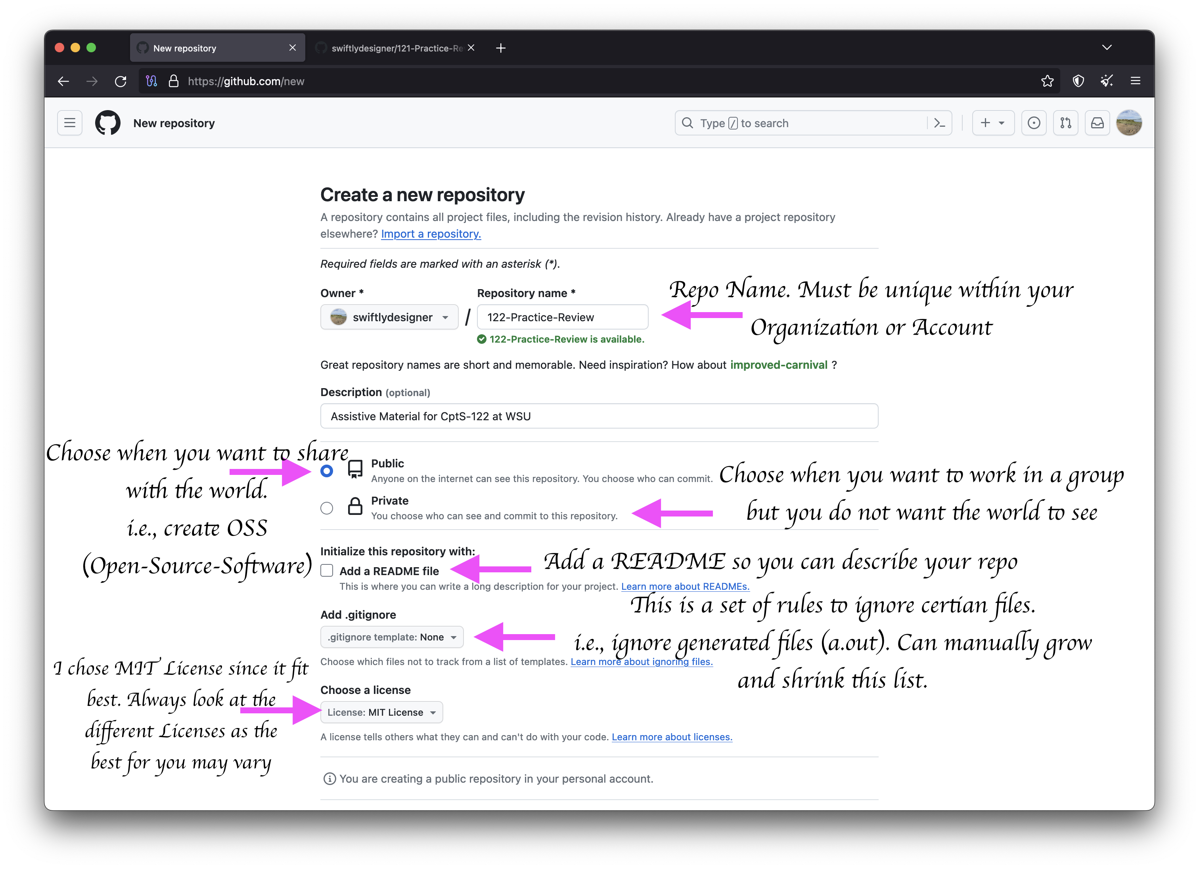
Provide Repo Details

Slide 17
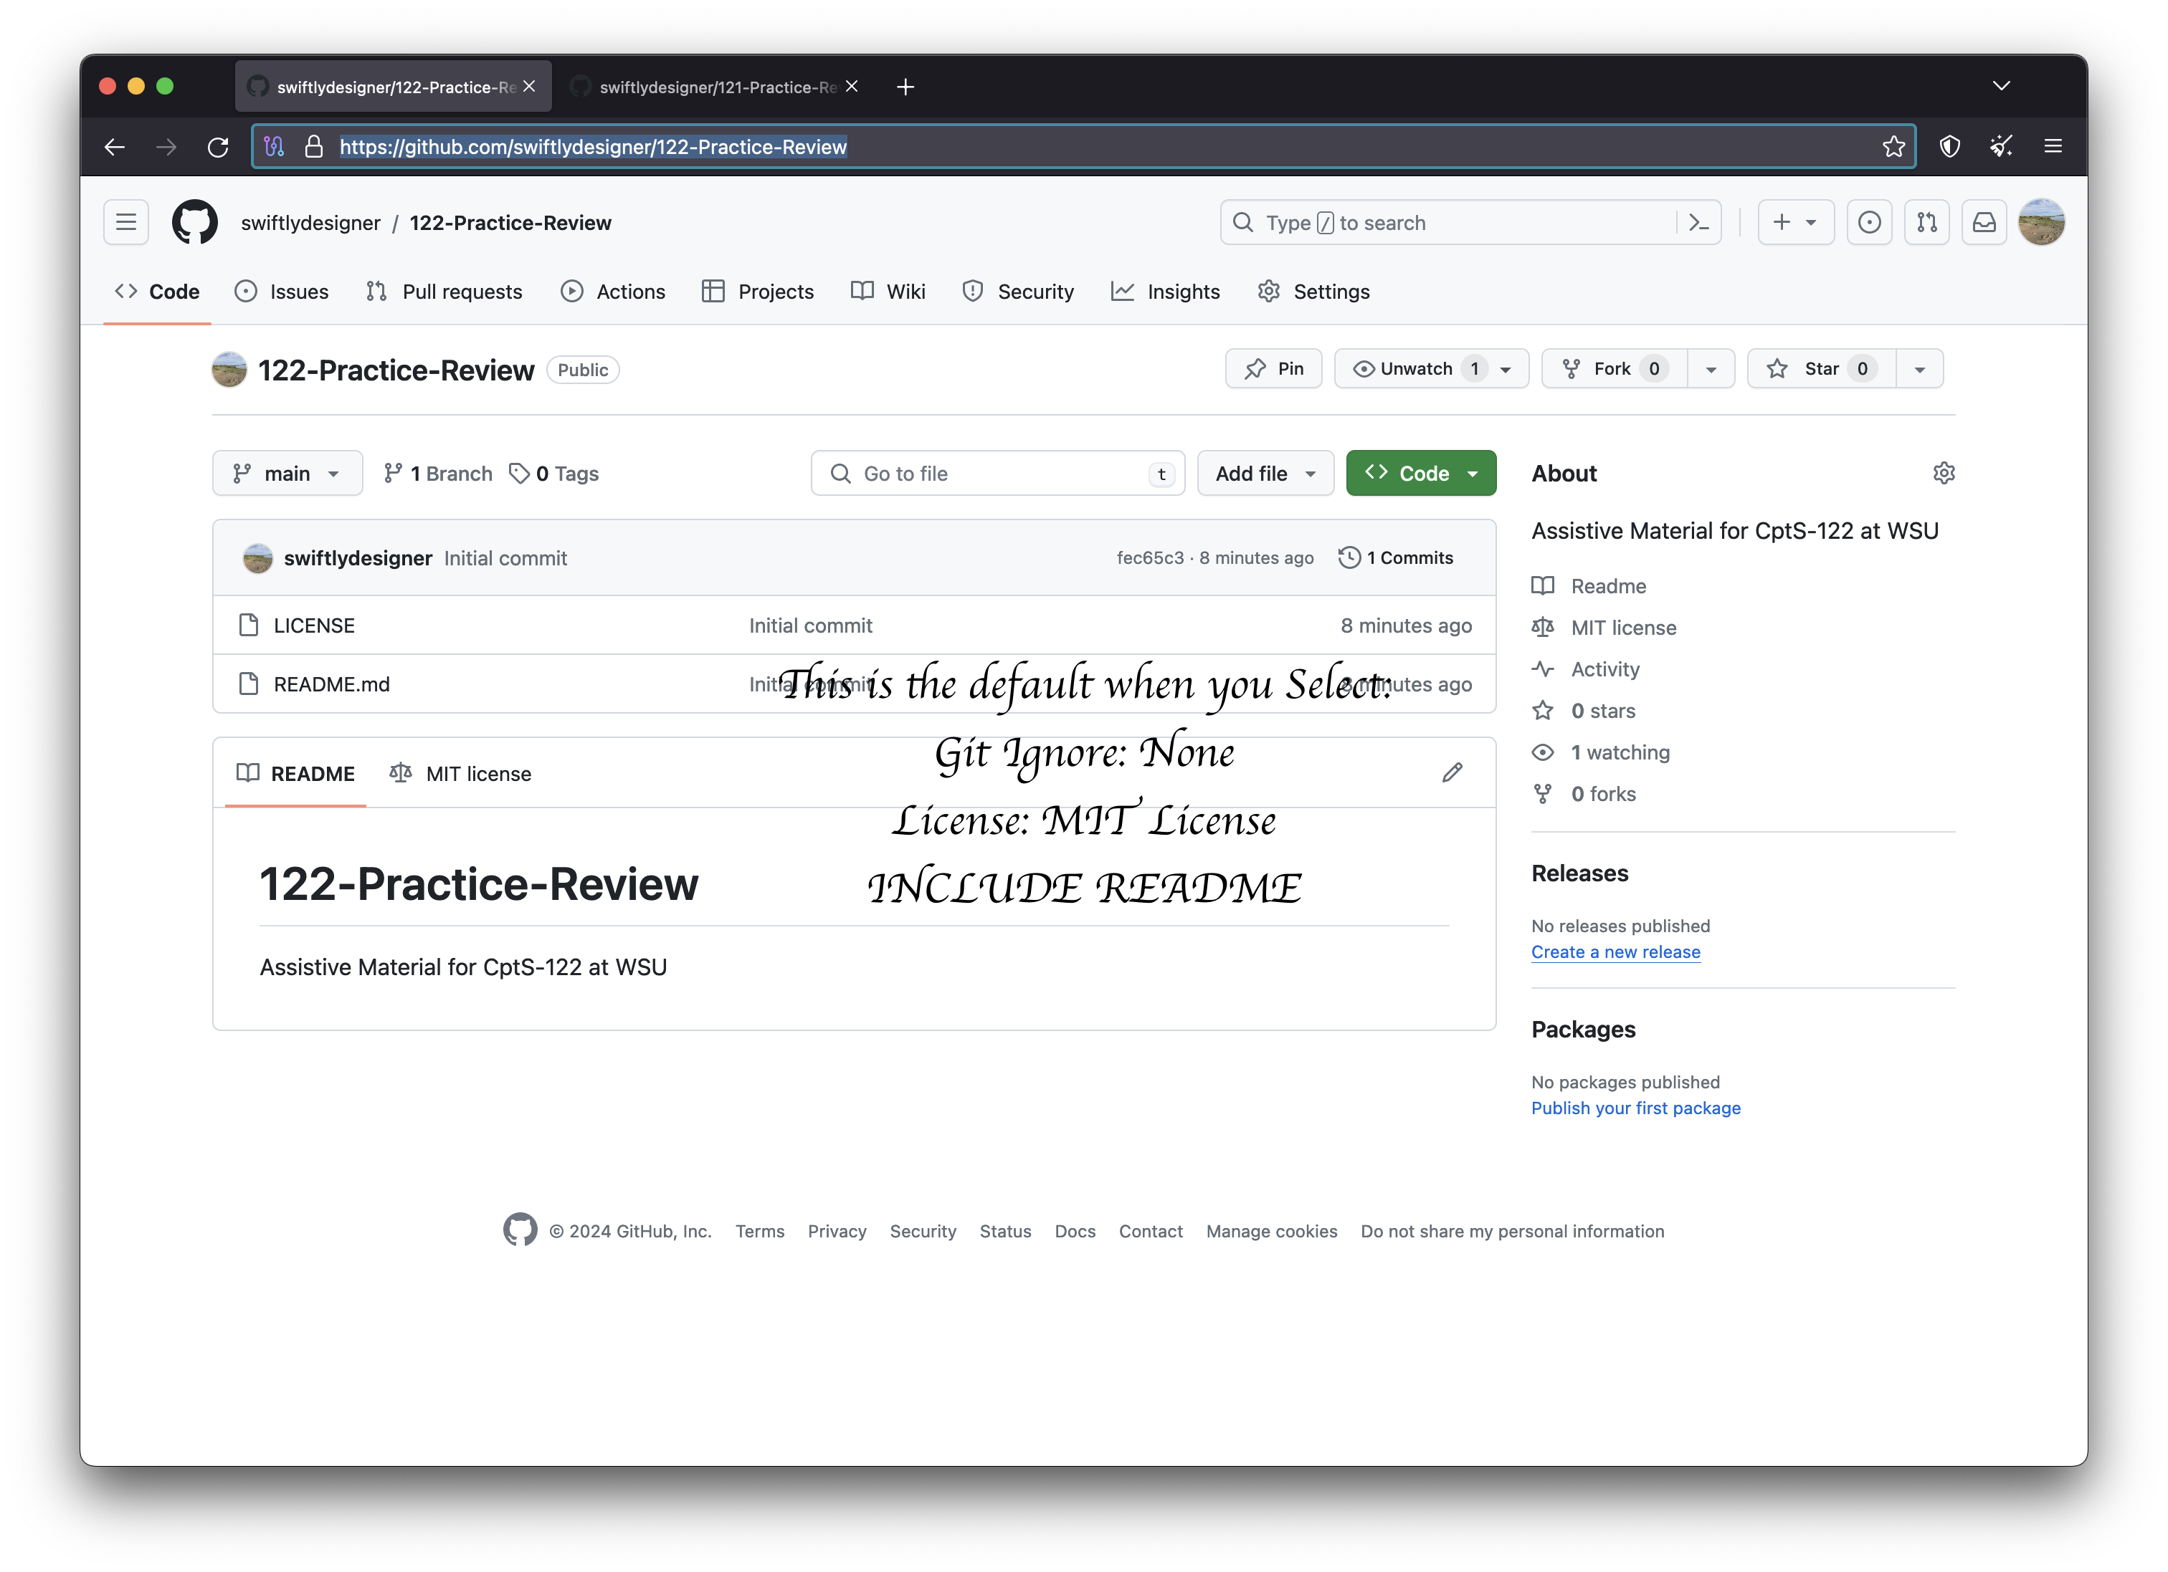
Default New Repo

Slide 18
Lab Repo
https://github.com/swiftlydesigner/122-Practice-Review
Feel free to share with friends!

Slide 19
Questions?

Slide 20
Lab #1 – Section 8
C Review

Slide 21
Dynamic Memory
What function do we use to allocate memory?
malloc (malloc, calloc, realloc)
void * malloc(size_t size);
void * calloc(size_t count, size_t size);
void * realloc(void *ptr, size_t size);
What function do we use to deallocate memory?
free
void free(void *ptr);
What is the difference between malloc and calloc (no, not the params)?
In calloc, “The allocated memory is filled with bytes of value zero.“

Slide 22
Linux Pointer
If I am using a *NIX (Linux, macOS, etc.) system, can I find out what malloc does and how to use it without internet?
Yes!
Linux or macOS users: try using it today! You will be requried to use it down the road.
You use the command `man`
Let's look at malloc

Slide 23
Check your understanding
What will line contain after the following call?
DATA.DAT (DATA_FILE): `Hello, World!`
VAR DECLARTION: `char line[5];`
CALL: `fgets(line, 5, DATA_FILE);`
Now, line is:
Hell

Slide 24
Check your understanding
Bubble Sort Steps:
Get length of array (or object used) (let's say MAX)
CUR = 0
Check CUR with CUR + 1 (SET CUR = 0 first round)
If CUR > CUR + 1, swap [Create a function which can handle any type!]
++CUR
Repeat [3] and [4] until CUR + 1 == MAX (we can also say CUR == MAX – 1)
--MAX
if MAX > CUR + 1 then GOTO 3
Sorted! (After O(N²))

Slide 25
Check your understanding
What types of data structures do we have?
Static
Dynamic
What are examples of static data structures?
Array
Struct
What are examples of dynamic data structures?
Lists
Stacks
Queues
Binary Trees
Binary Search Trees (BST)

Slide 26
Check your understanding
What is Guard Code?
#IFNDEF MY_HEADER_H
#DEFINE MY_HEADER_H
// Whatever you need in your header
#ENDIF /* MY_HEADER_H */
Why do we like it?
It is structured
It prevents circular references
It prevents duplicates

Slide 27
Recursion
A function or method that could call itself at least once
Could increase the performance on some devices
Increases memory usage which could decrease performance
Makes some code easier to write (compared to loops)

Slide 28
Bit manipulation
EXCLUSIVE OR (XOR) ^
One or the other is 1
Exactly 1 bit is 1
OR (OR) |
At least one bit is 1
AND (AND) &
Both bits are 1
Exactly 2 bits are 1
I1 | I2 | AND (&) | XOR (^) | OR (|)
0 | 0 | 0 | 0 | 0
1 | 0 | 0 | 1 | 1
0 | 1 | 0 | 1 | 1
1 | 1 | 1 | 0 | 1

Slide 29
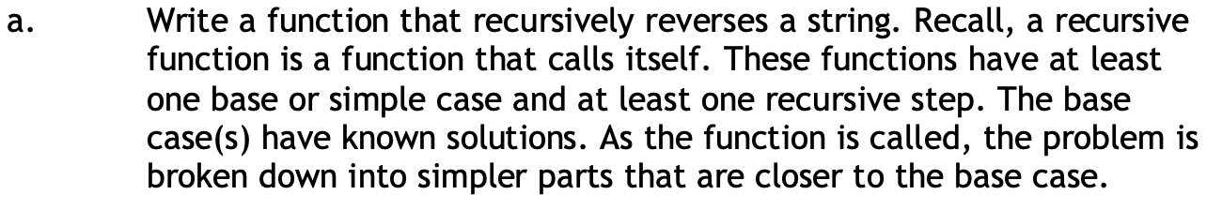
Problem 1 (30 min)
Set a to the first char in str
Pass from after a in str to itself
Insert a at the end

Slide 30
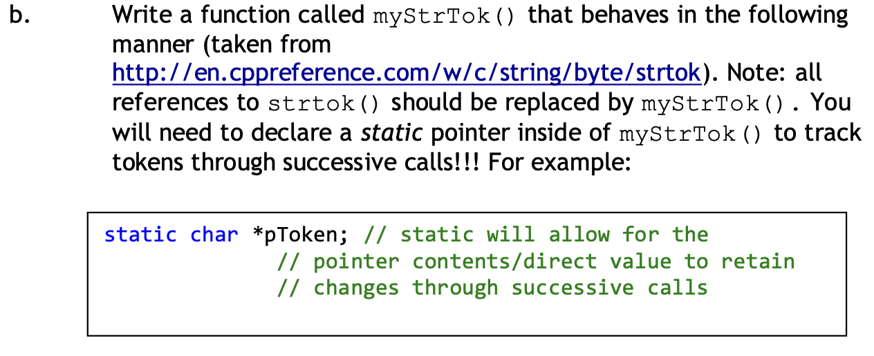
Problem 2 (50 min)
Find test cases on my GH.

Slide 31
Problem 2 Challenge
If you finish all problems, write a function for strtok_s
strtok_s is the thread-safe version of strtok
this means there is no static variable within strtok_s
Threads
A way of running code ”concurrently”
Practically, only X programs run at the same time, based on X processors (4 cores = 4 programs running at once
If you have 100 programs and 10 cores, then they will switch between contexts and only 10 run in parallel. More on this in CptS 360!

Slide 32
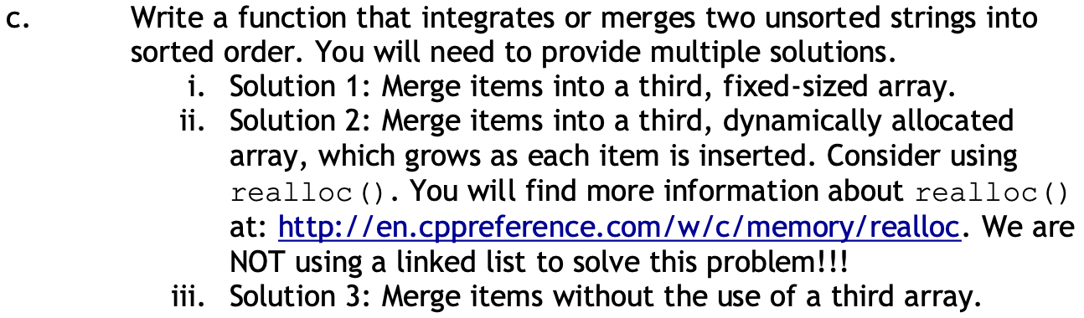
Problem 3 (60+ min)
The first solution should be very easy
The second one should be moderately easy
The third has a few ways to approach it

Slide 33
Questions?

Slide 34

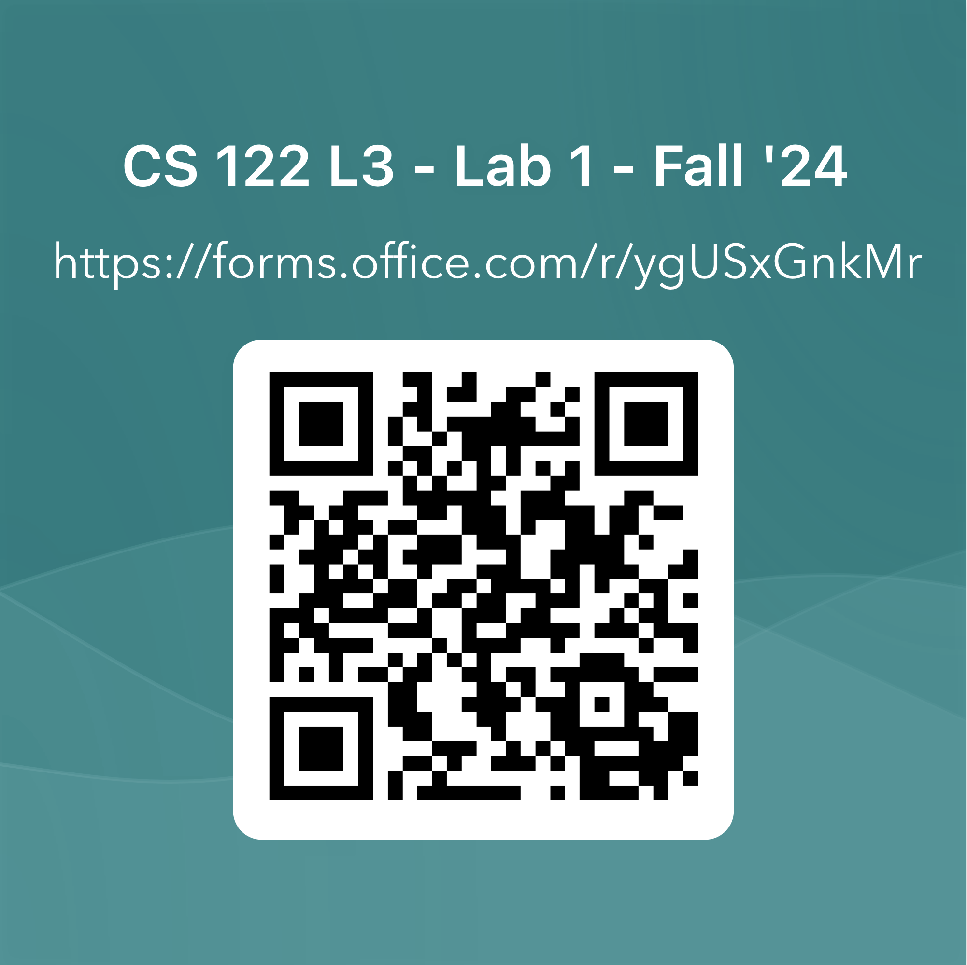
Attendance
Enter Code:
First

